Slide 1


Successful and Profitable Product Launch on Kickstarter
Aidan Au
10/25/2021

Slide 2
Agenda (to be updated)
Successful and Profitable Product Launch on Kickstarter
Background - Why Do People Go To KickStarter? 3
Pros and Cons of Launching a Product on Kickstarter 4
Notable Projects On KickStarter 5
Business Problem / Research Question 10
Data Set Characteristics 12
Analysis – Key Results & Recommendation 15
Future Work / Next Steps & Improvements 24
My GitHub Link to the Project

Slide 3
Background Why Do People Hang Out On KickStarter?
Business Owners/ Creators
Bring a product idea to life - from developing a prototype to selling
Validate a proof of concept or a viable idea from the market
Sell then build instead of building first then selling second
Get startup cash/initial funding without giving up equity/taking a loan
Paying Customers/ Backers
[Describe here the problem to solve and analysis/approach required to find the solution]
Pay to support creators who will bring new products to life and to save from future retail price
To have early access to new or innovative products than customers outside of Kickstarter

Slide 4
Pros and Cons of Launching a Product on Kickstarter Risks and Rewards
Advantages
Get startup cash/initial funding without giving out equity/taking a loan
Solve cash flow problem - pre-selling products BEFORE available and taking pre-orders; Flip the timeline - generate pre-revenue before even having a product to sell or paying for inventories
You can raise more money even if your funding goal is met (over-funded)
A global community of millions of repeat customers/backers actively browse Kickstarter and ready to pay to support projects (which potentially lower the customer acquisition costs)
Alternative funding vs traditional financing such as loans from friends and families, (high-interest) SBA loans from banks, angel investors/venture capital, or Shark Tanks/Dragons' Den
Customer research - getting feedback for earlier version of your products
Not obligated to develop a product or pay Kickstarter a fee if your funding goal is not met. Customers/backers of a project don’t get charged until the project has met its funding goal/the project is successful.
Disadvantages
Hurt chances of getting subsequent funding from investors if a project failed. What will The Verge, CNET, engadget, or TechCrunch write about your failed campaigns?
All-or-nothing funding model (Zero funding if you fail to hit your funding goal)
Not all projects/products do well on Kickstarter - choose wisely
Customers may be deterred by projects with a longer duration; A shorter duration may lead to a failed and under-funded project

Slide 5
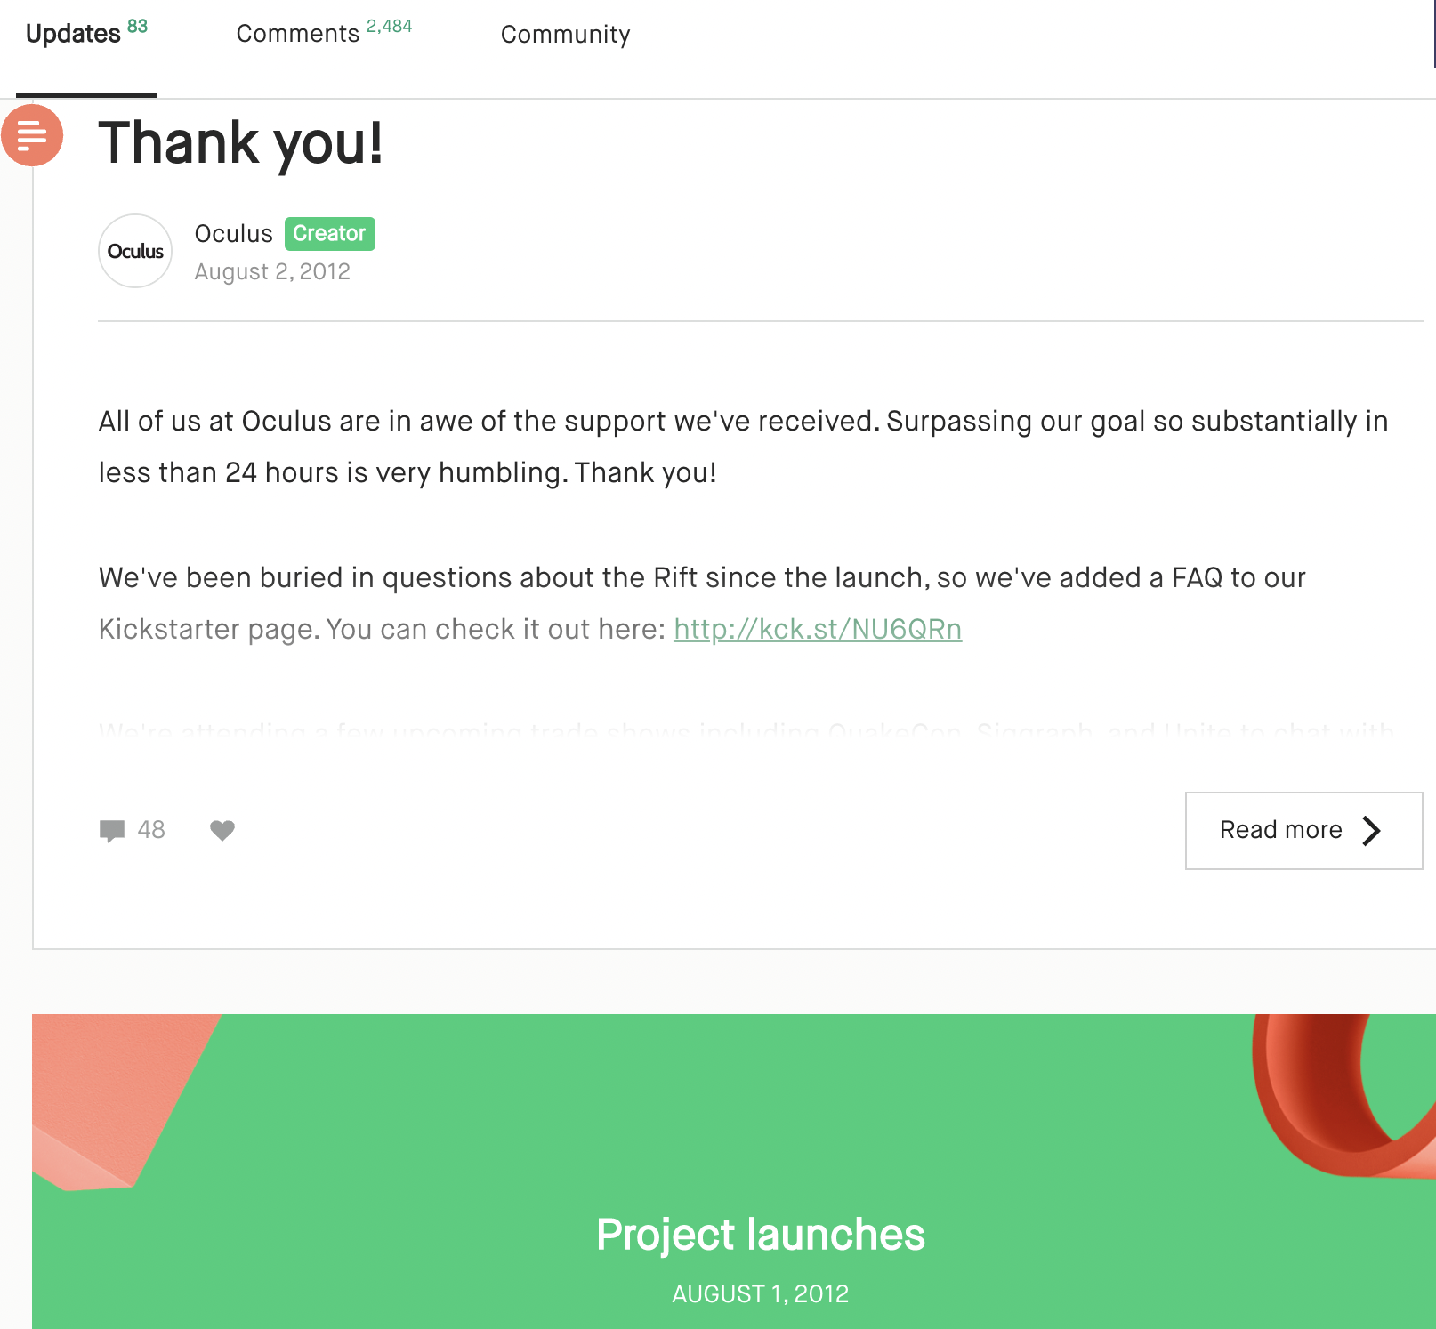
Oculus Launched A Product on KickStarter in 2012 (Before They Were Acquired by FB in 2014)

Slide 6
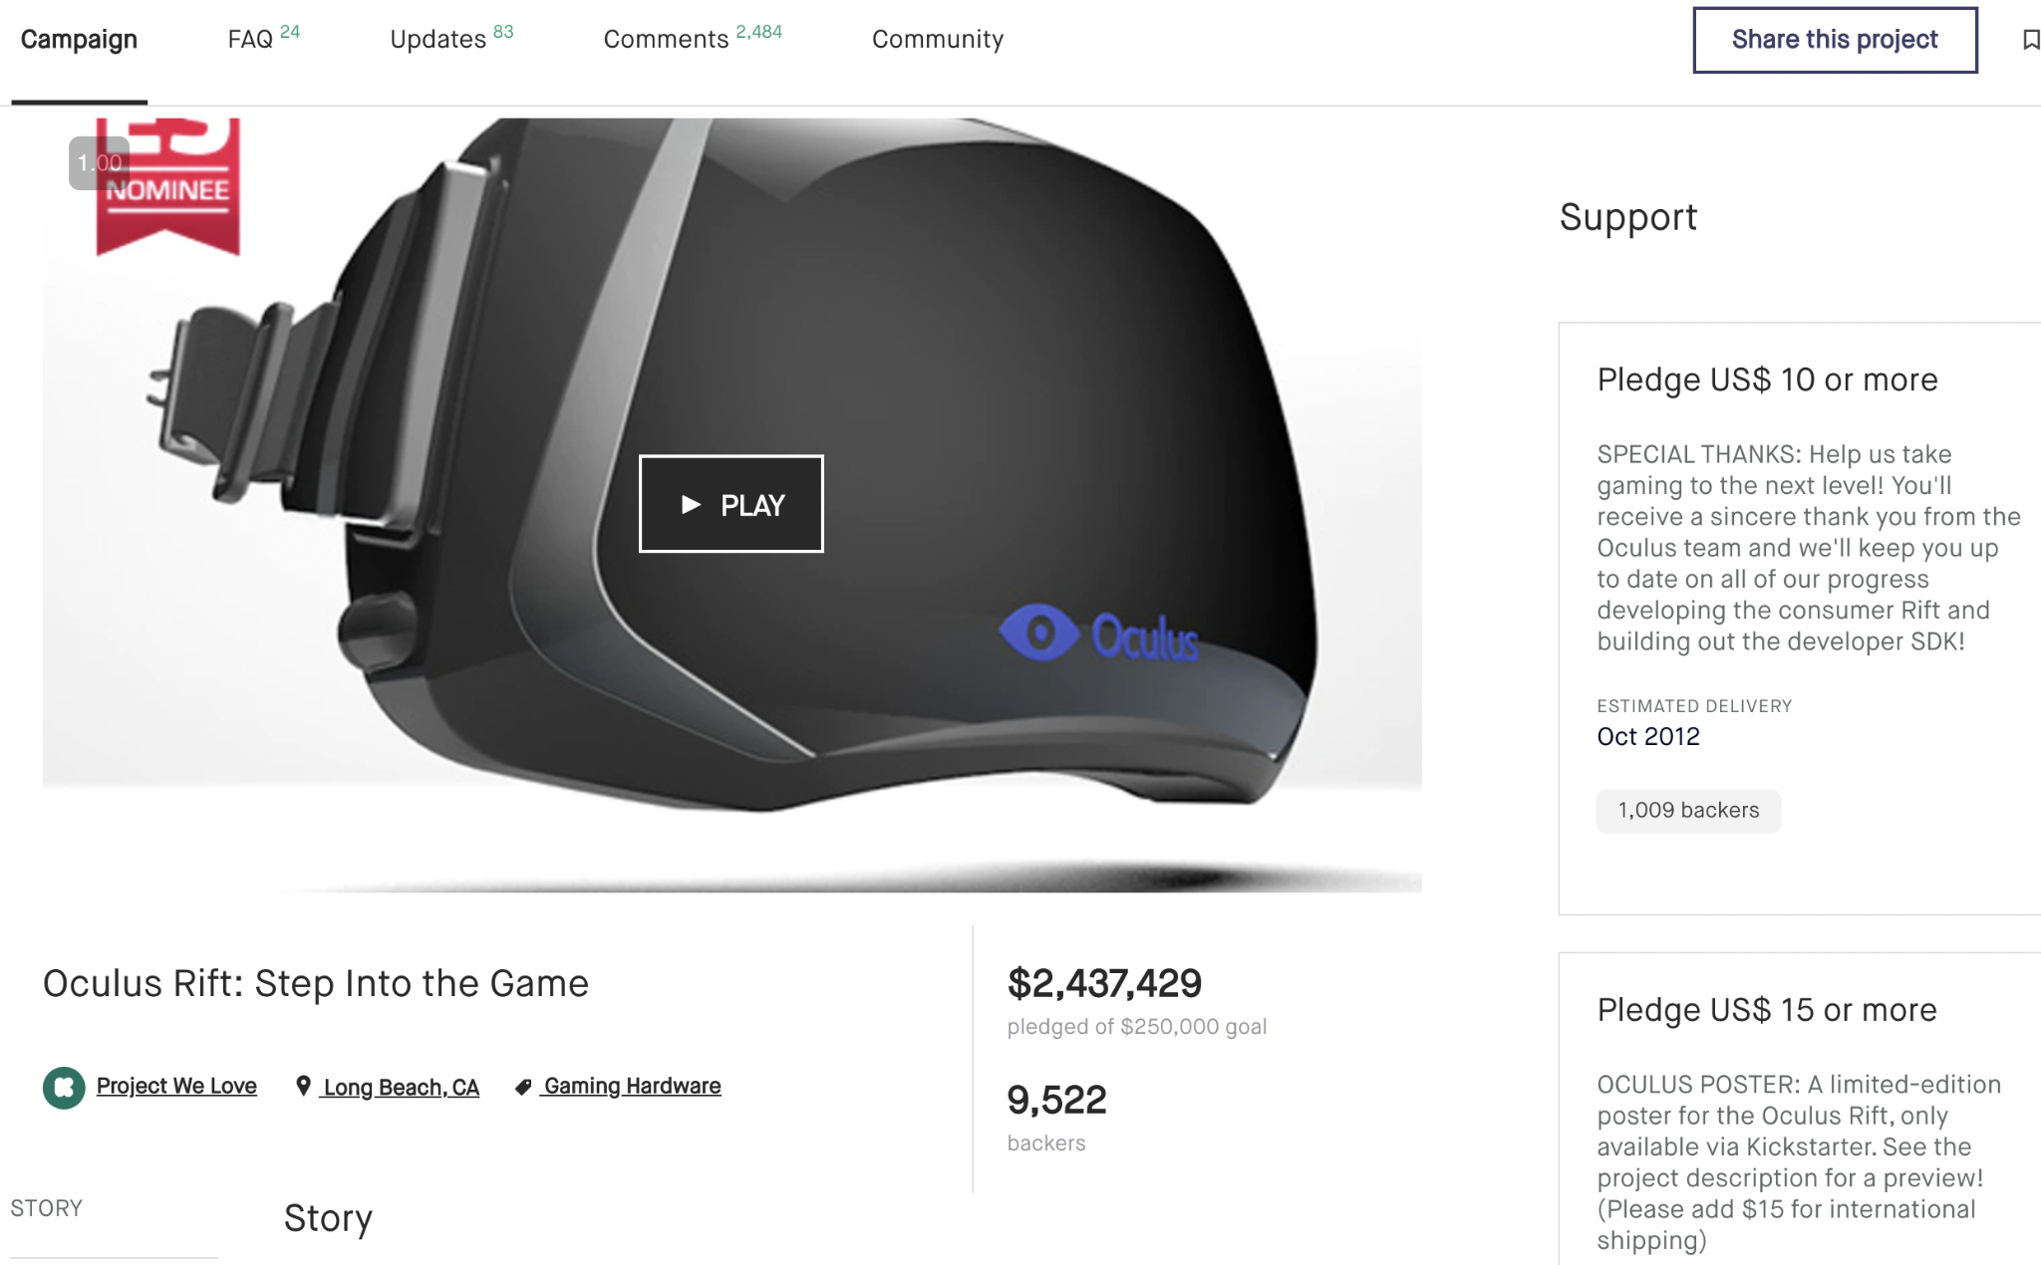
Oculus Surpassed Its Goal of $250k in Less Than 24 Hours
Backers

Slide 7
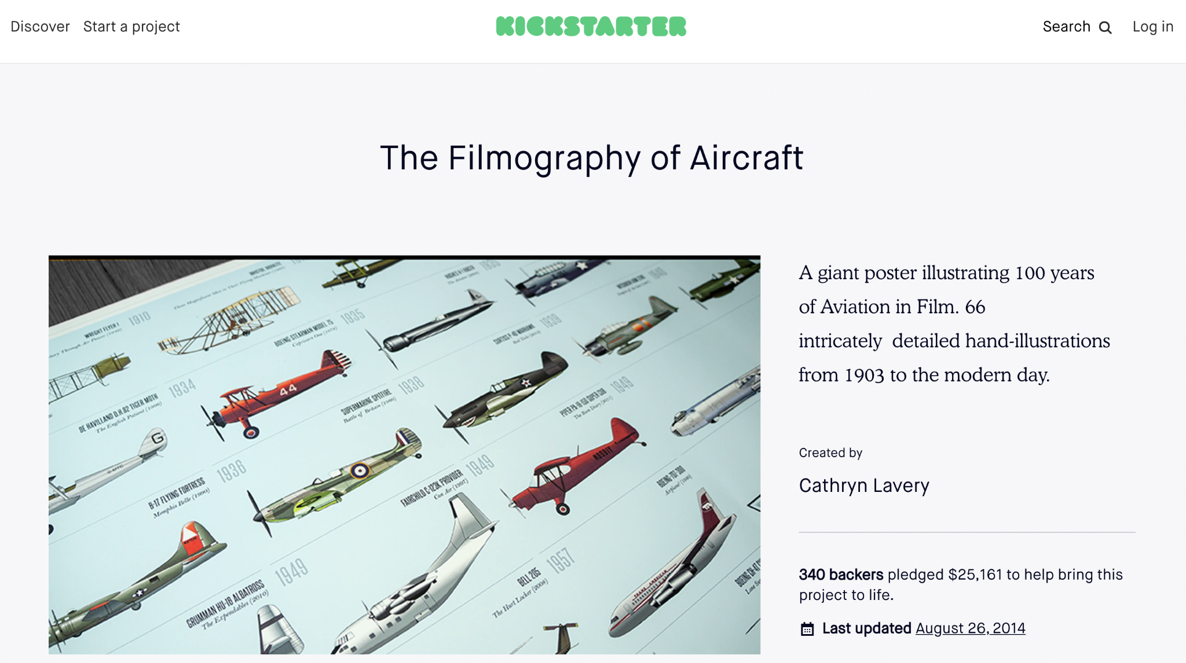
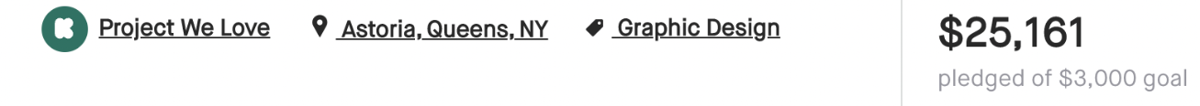
A Coffee Table Book by Cathryn Lavery

Slide 8
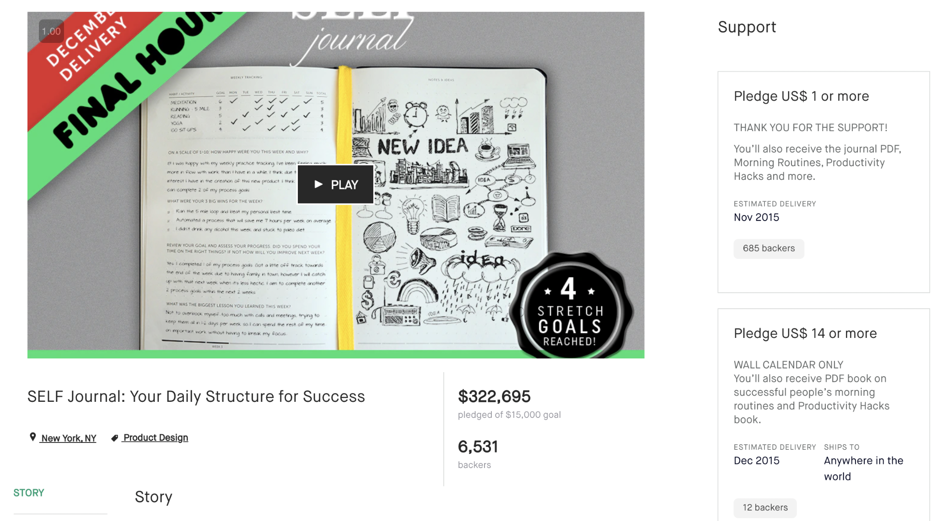
SELF Journal by Cathryn Lavery of Best Self Co.

Slide 9

SELF Journal by Cathryn Lavery of Best Self Co.

Slide 10
Overall Success Rate on Kickstarter
Success Rate: 39.18%
Unsuccessful Rate: 60.82%
Source: Stats page on Kickstarter.com, Last updated: Sat, October 16 2021 12:12 PM EDT

Slide 11
Success Metrics
1. Success Rate/Failure Rate
2. Amount Raised for the Projects (i.e. Amount Pledged by the Backers)

Slide 12
Business Problem / Research Questions
Question 1. How do you pick a winning category to successfully fund your projects on Kickstarter, and what to avoid?
Question 2. Does the length/duration of a project play a role in its success/failure?
Question 3. How can you raise as much money as possible?

Slide 13
Data Set Characteristics Follow The Data
Dataset Information
Dataset Visualizations
Made Available by Mickaël Mouillé on Kaggle
378,657 projects/data points
77% of data points were projects launched in the US, which were used in the upcoming data analysis
No duplicates
15 Main Categories of projects
Other columns include
the number of backers,
the amount of money a project raised (amount of money pledged by supporters),
goal amounts,
launch dates and deadlines,
state: successful, failed, canceled, suspended or live
Kickstarter was founded on April 28, 2009. Data from 2009 to January 2018 were used in the analysis.

Slide 14
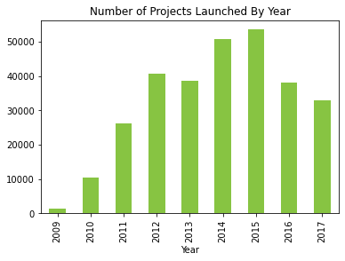
Growth On Kickstarter Since Founded

Slide 15
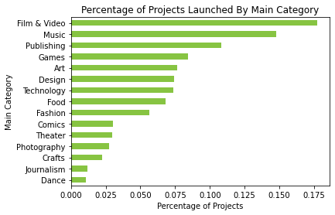
Popular Project Categories On Kickstarter

Slide 16
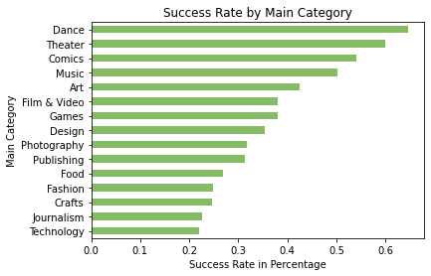
Question 1. How to pick a winning main category to successfully fund your projects on Kickstarter, and what to avoid? Projects/Products that have typically succeeded/failed

Slide 17
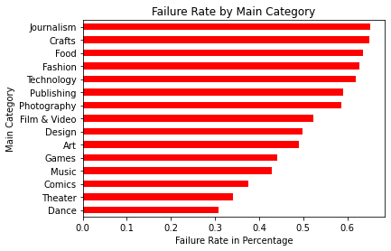

Slide 18
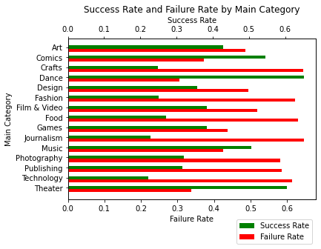

Slide 19
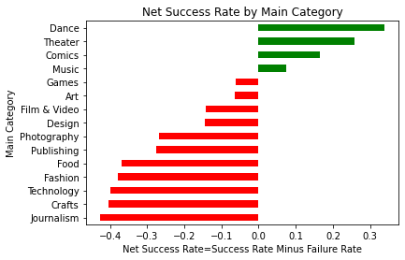
Go After the Categories That Have More Winners Than Losers. There’re Still Money To Be Made On Kickstarter

Slide 20
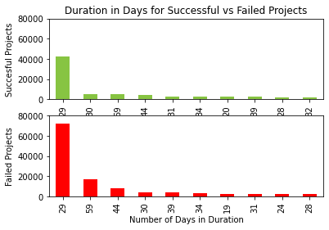
Question 2. Does the length/duration of a project play a role in its success/failure?

Slide 21
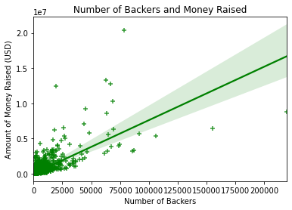
Question 3. How can you raise as much money as possible?

Slide 22
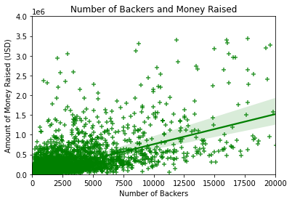
Looking Closely At The Bottom Left Part Of The Last Chart

Slide 23
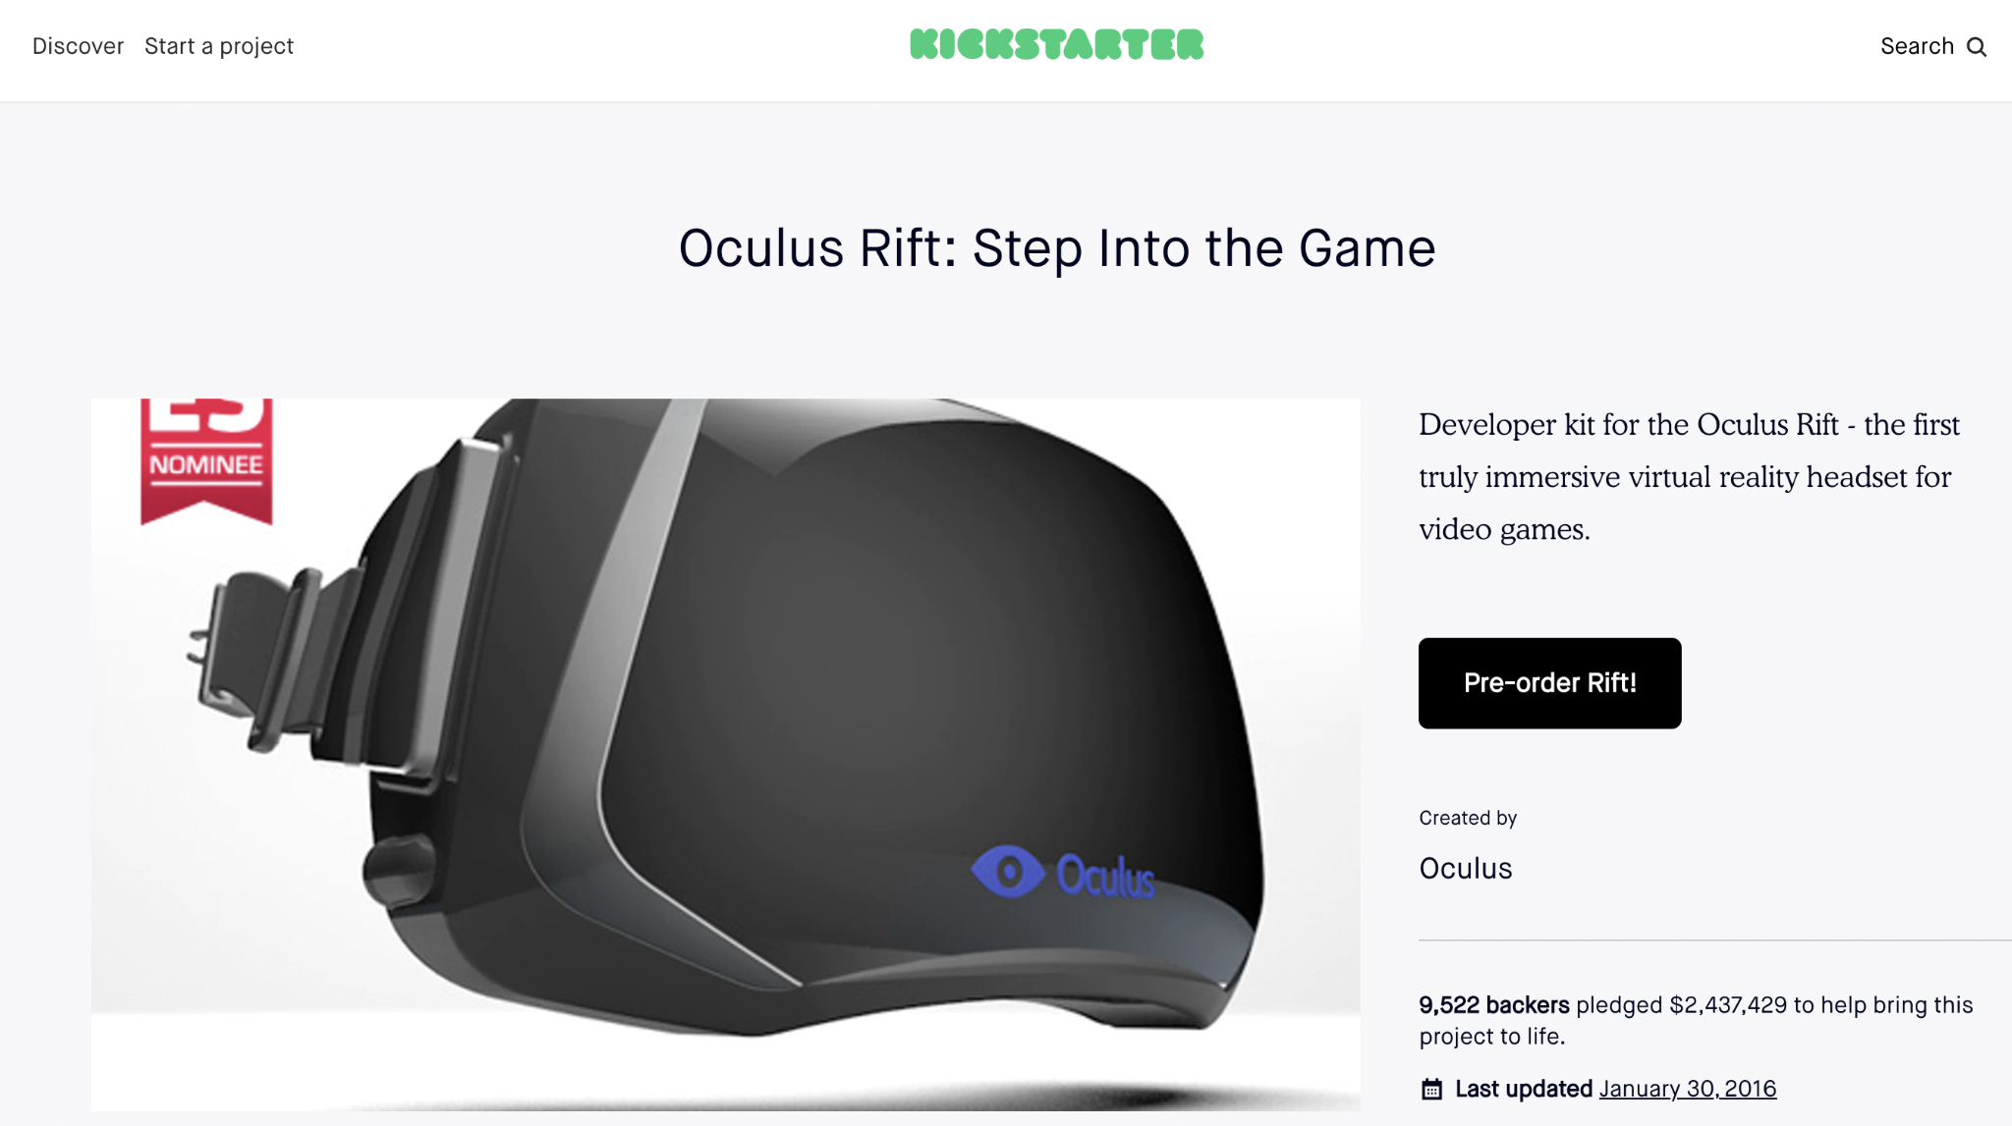
There is a high correlation between the number of backers and the amount pledged by the backers/the amount raised for the projects
Positive Relationship

Slide 24
Recommendation: Always Include A Reward Level Of $1
To get an easy yes from a backer and, and hence to increase the number of backers
Your reward can be, for example, a personalized thank-you video from the Founder(s)
The more money you raise, the more likely your projects are going to succeed

Slide 25
Next Steps & Improvements
Project/Approach Improvements
Lessons learned
Use more recently web-scraped data (scraped once a month)
Build a model to predict the success of a project (Target Variable); Build the model for production ready to be deployed
Future Data collection/feature engineering: Explore other relationship/correlation with features such as the number of comments, updates, and reward levels, etc. (More Predictor Variables)
Expand the project but with more data from other crowdfunding websites such as IndieGoGo, GoFundMe or Product Hunt.
Talk to domain experts in Kickstarter and crowdfunding
Why I did not web-scrape or use web-scraped data --- Ideas are a dime a dozen. Execution is everything. Ideas are Only as Good as the Execution
Took additional data visualization courses on using subplots and overlaying two plots into one

